Slide 1

Optimizing Enterprise Java for a Microservices Architecture

Slide 2








Enterprise Java Standards History
J2EE 1.2
J2EE 1.3
J2EE 1.4
Java EE 5
Java EE 6
Java EE 7
Java EE 8
2000
2005
2010
2015
2020
Release Cadence
Notes:
Java EE has been an extremely successful platform. The JCP has been the steward of over 20 compatible implementations over its nearly 20 year history, resulting in a $4B industry. These are just some of the Java EE compatible implementations that exist.
In its early stages, J2EE grew somewhat quickly (perhaps too quickly) as the platform needed to address the immediate needs of the enterprise. Beginning with Java EE 5 in 2006, the pace began to slow as the platform began to mature. Java EE is now following the slower release cadence that a standards organization typically reflects. A standards-based release cadence by design does not address ew and rapid innovations.

Slide 3

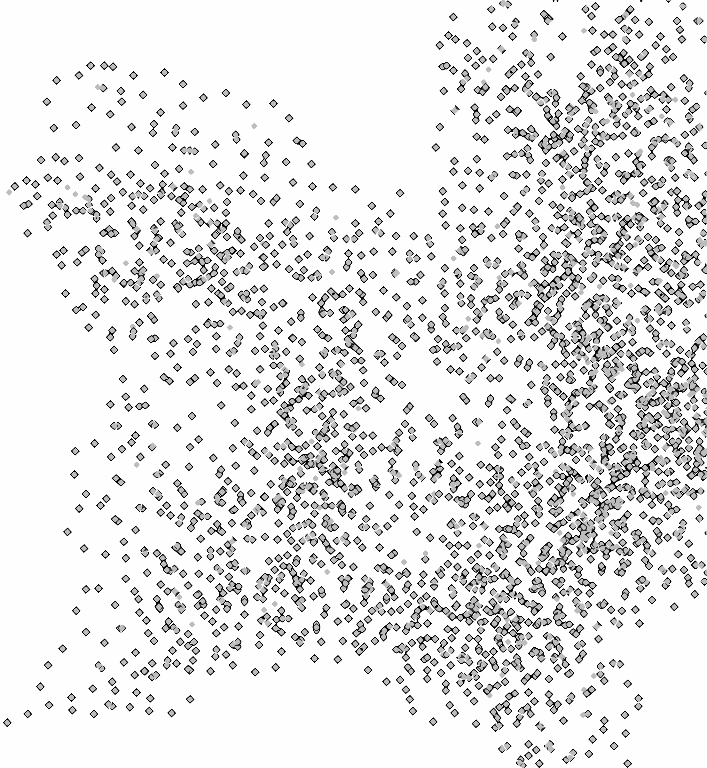
Fundamental Shifts in Computing
Cloud
Reduce time to market
Address unpredictable loads
Pay as you go
Containerization
Microservices
Deliver new features more quickly
Smaller, more agile teams
Deliver business features as discrete services
Scale services independently

Slide 4
MicroProfile Background
Began as a collection of independent discussions
Many innovative “microservices” efforts in existing Java EE projects
WildFly Swarm
WebSphere Liberty
Payara
TomEE
Projects already leveraging both Java EE and non-Java EE technologies
Creating new features/capabilities to address microservices architectures
Quickly realized there is common ground
Java EE technologies are already being used for microservices, but we can do better

Slide 5




MicroProfile Release Philosophy
Rapidly iterate and innovate
Build consensus
Release 1.0
Standardize
JAX-RS CDI JSON-P
Sept 2016
Notes:
The goal of the MicroProfile release philosophy is to strike a healthy balance between the benefits of open collaboration and the value of standards. Release 1.0 is scheduled for Sept, 2016 to get the MicroProfile into developers hands quickly. Vendors and various open source projects will continue to innovate with microservices within their own communities, but collaborate in areas of common interest. For example, there are common use cases that need to be addressed, popular 3rd party frameworks and standards we all support, and perhaps new APIs that we can co-develop. Even during these iterations we’ll be raising the bar for application portability. After multiple iterations of MicroProfile there will be enough features and consensus to result in a formalized standard. The process then starts over again with a new set of use cases.

Slide 6

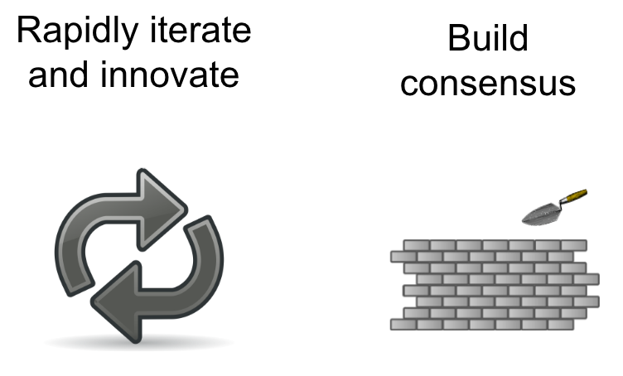
Bridging Community and Standards
Vendor Choice Implementation Choice
Application Portability
Backwards Compatibility
Reduced Risk
Broad Collaboration
Encouraged experimentation Fail Fast Rapid innovation
Notes:
The community and “leading edge” companies often think that standards are too slow, and enterprises often think that the community projects move too fast and introduce too much risk. The MicroProfile bridges that gap by collaborating in areas where eventual standardization and shared investment makes sense in order to increase the pace towards standardization.

Slide 7
Feature Backlog* - Help us prioritize [1 of 2]
Container API
Microservic-y annotations (Ex: @CircuitBreaker)
Testing
Distributed Logging
Distributed Tracing
OAuth2/OpenID Connect
Microservice Security
Service Discovery
Health Check
Configuration
Metrics/Monitoring
WebSockets
JSON-B
Bean Validation
JPA
JTA
Concurrency Utilities for Java EE
* Some Items may be removed due to lack of interest

Slide 8
Feature Backlog* - Help us prioritize [2 of 2]
Messaging / Eventing
Asynchronous/Reactive Support / Patterns
Integration with Reactive / Eventing systems
Big Data/NoSQL strong & weak consistency support
NetFlix OSS Integration
JCache
JDK 8 Lambda+Streams
EJB Lite
Servlets
HTTP/2
Startup Time
Disk Space
Memory
Uber-jar
Java 9 Modularity
* Some Items may be removed due to lack of interest

Slide 9
Release Schedule
MicroProfile 1.0
Move to Foundation
MicroProfile 1.1
MicroProfile 1.2
Sep 2016
Q4 2016
2017
2017

Slide 10







Join the Community!

Slide 11
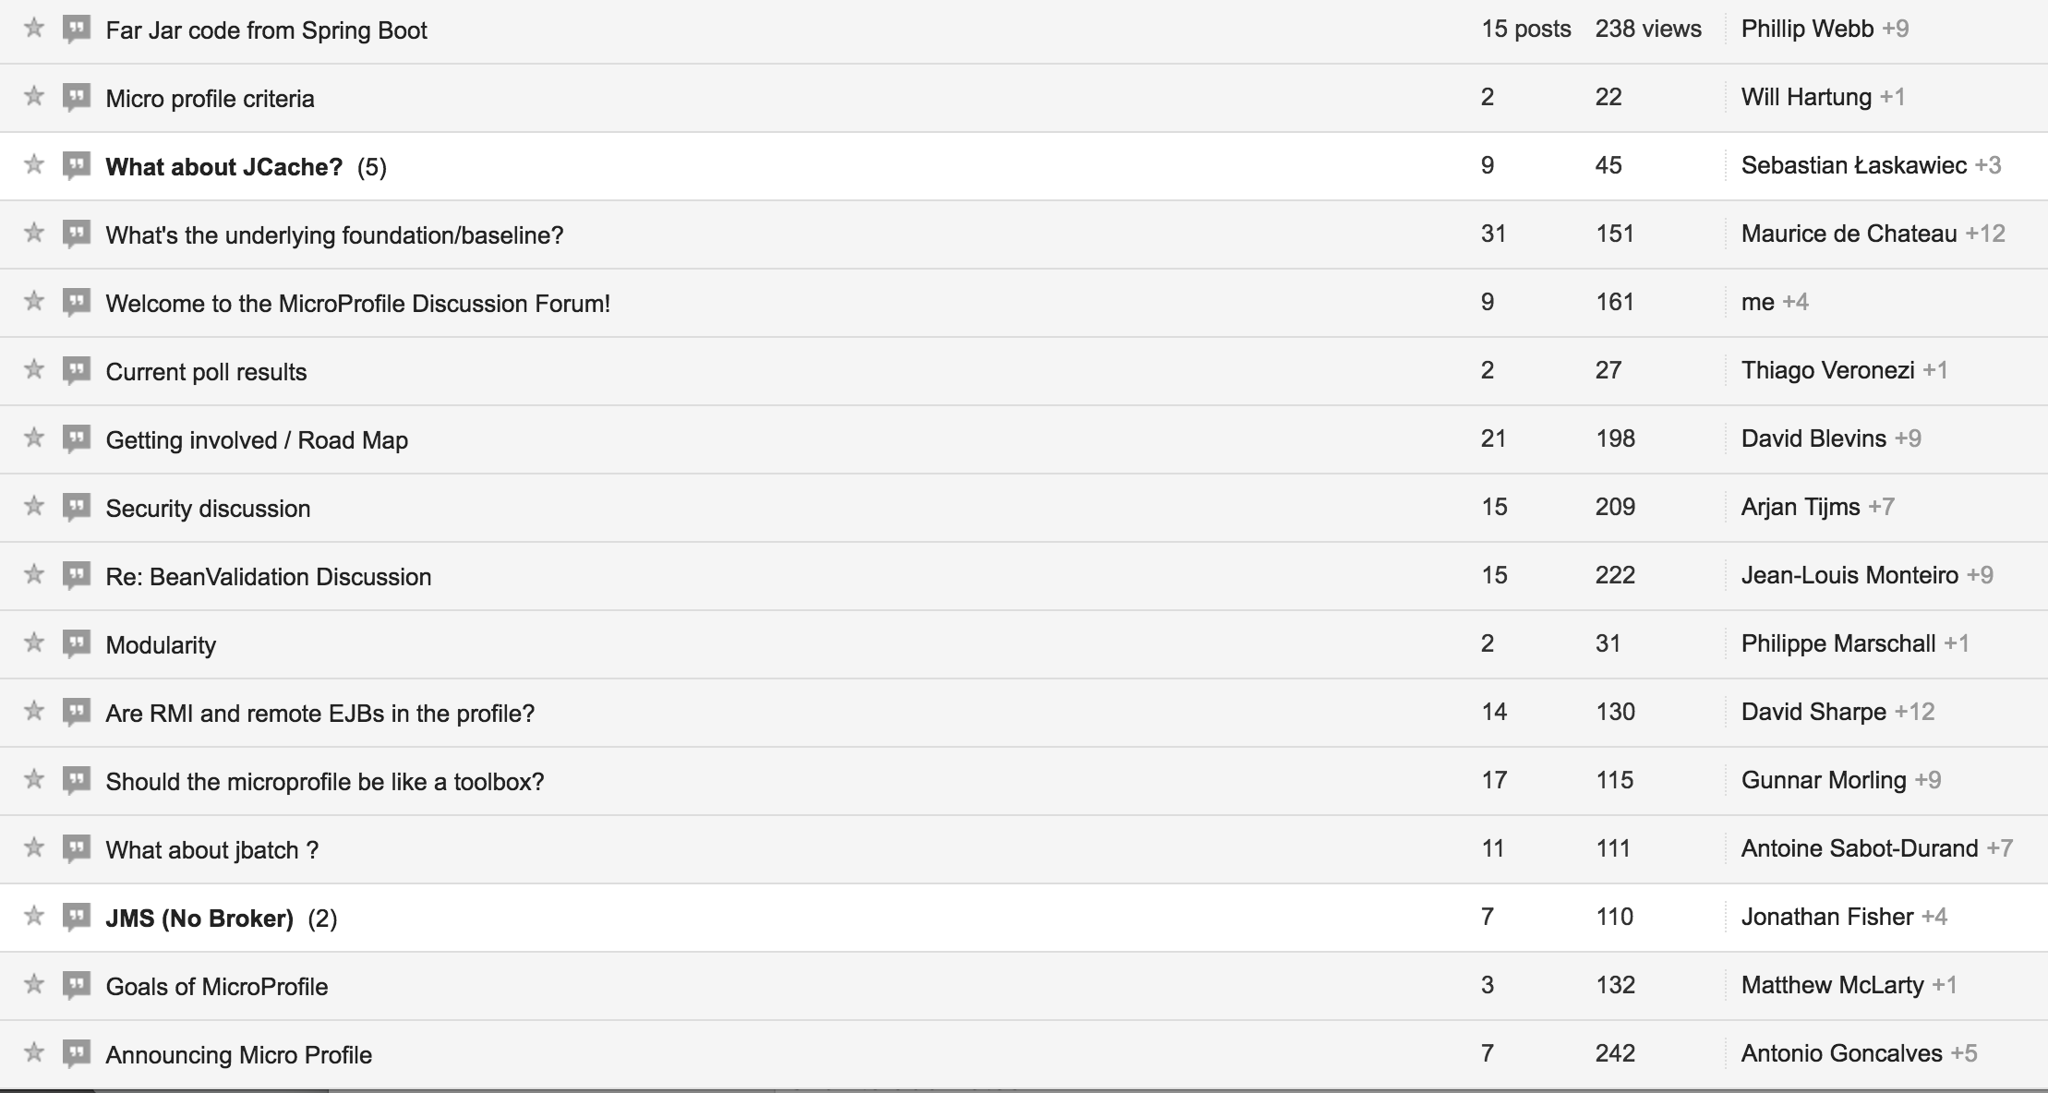
Join the Discussion!
https://groups.google.com/forum/#!forum/microprofile

Slide 12
Resources
MicroProfile.io
MicroProfile Discussion Forum bit.ly/MicroProfileForum
MicroProfile Examples https://github.com/microprofile/microprofile-samples

